Slide 1

How to use Rheology to Characterize and Formulate Nanofiber Based Materials
TAPPI Nano Division
Yaman Boluk
University of Alberta
and
National Institute for Nanotechnology, National Research Council of Canada
Edmonton, Alberta Canada
November 9, 2016

Slide 2
Outline
What is and why rheology?
Rheological terms
What and how to measure?
Cellulose Nanocrystals (CNC)
Cellulose Nanofibers (CNF)

Slide 3
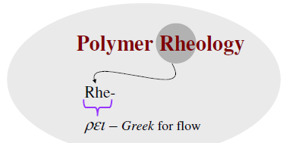

What is rheology ?
-------------
Fill in the blank:
Polymer melt
Polymer solution
Suspension
Food
Ink
Paint
Glacier
Cement mixture
NANOCELLULOSE
suspensions
For scientists, engineers and laymen, rheology is observations or expressions of how the stress in a material or force applied to a material is related to deformation (change of shape) of the material.

Slide 4
Rheology Explains Behavior
Drop onto a concrete floor four objects:
  a gum eraser
  a cube of halite
  a ball of soft clay
  one cm³ of honey
When they fall, they behave the same by following the Newton’s Second Law (F = mg)
Their difference is when they reach the ground:
  The eraser rebounds and bounces (elastic)
  The clay flattens and sticks to the floor (ductile)
  The halite fractures and fragments scatter (brittle)
  The honey slowly spreads on the floor (viscous)

Slide 5
Why rheology?
Predict the field performance of the material
Understand physical properties of the materials and interactions among components

Slide 6
Rheology and its place among other sciences and applied problems
From: A. Ya. Malkin, Rheology Fundamentals, ChemTec Publishing

Slide 7
Material Parameters
Rheology depends on:
  Extrinsic (external) conditions such as:
    P, T, t, chemistry of the environment
  Intrinsic (internal) material properties such as:
    Nanocellulose dimensions, surface properties, concentration, continuous phase

Slide 8
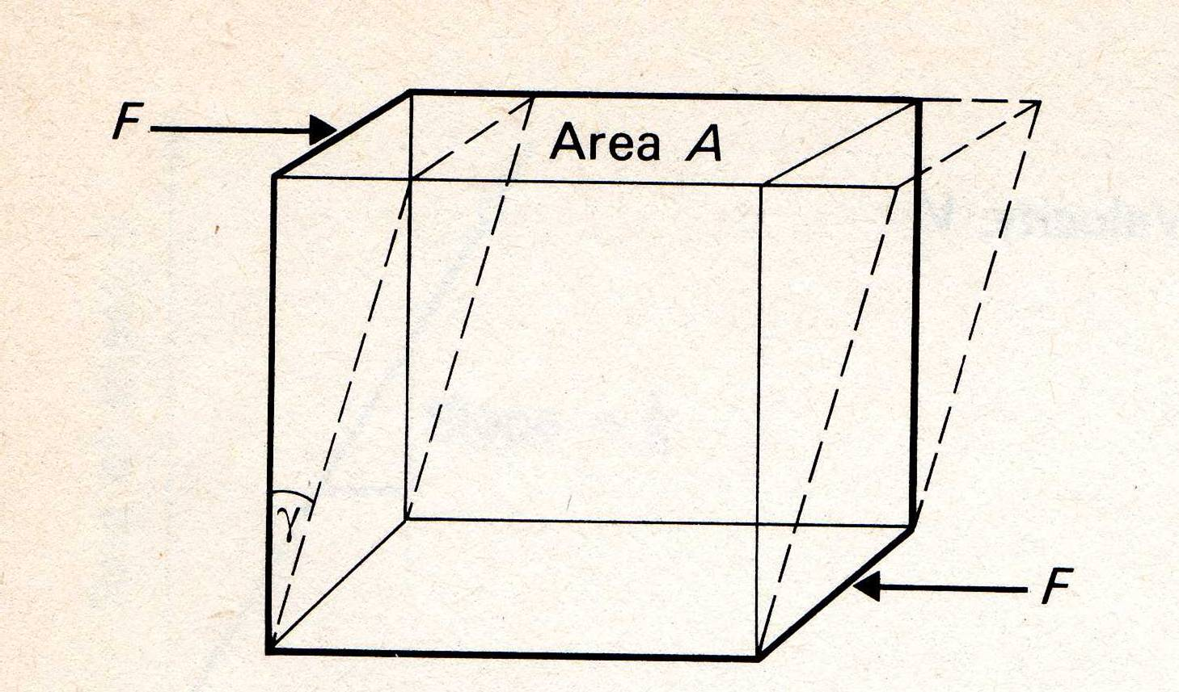
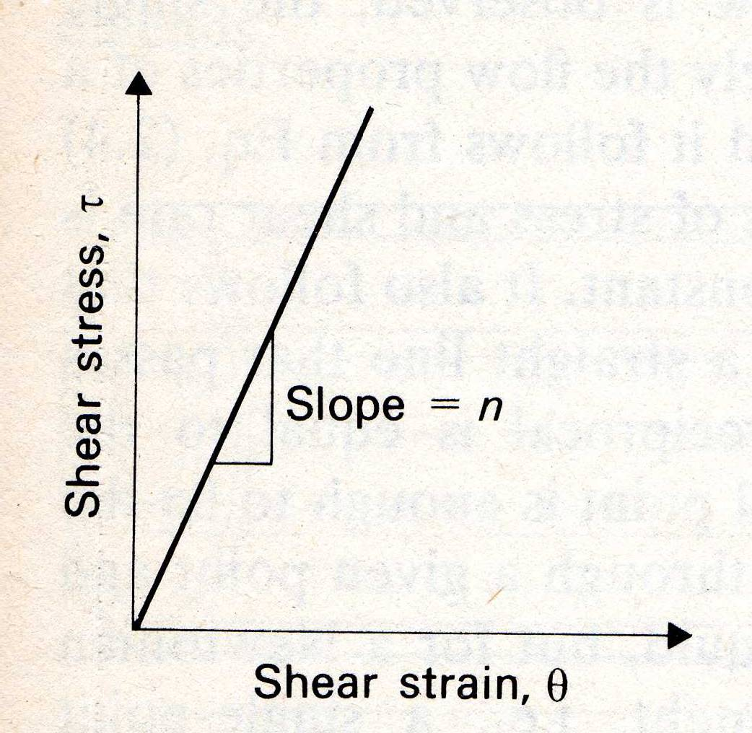
Hooke’s Law for a Material under Shear Deformation
τ = Gγ
Shear stress, τ
slope = G
Shear strain, γ
Consider a rectangular prism that is deformed by the application of equal and opposite forces, F, applied tangentially to opposite faces of the prism, each of area, A.
The prism will be deformed in the manner shown, under the shear stress of
  τ = F/A

Slide 9
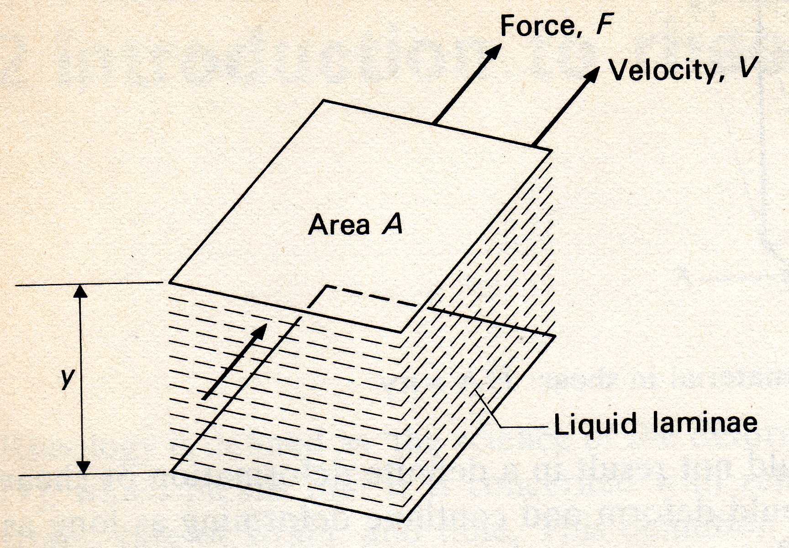
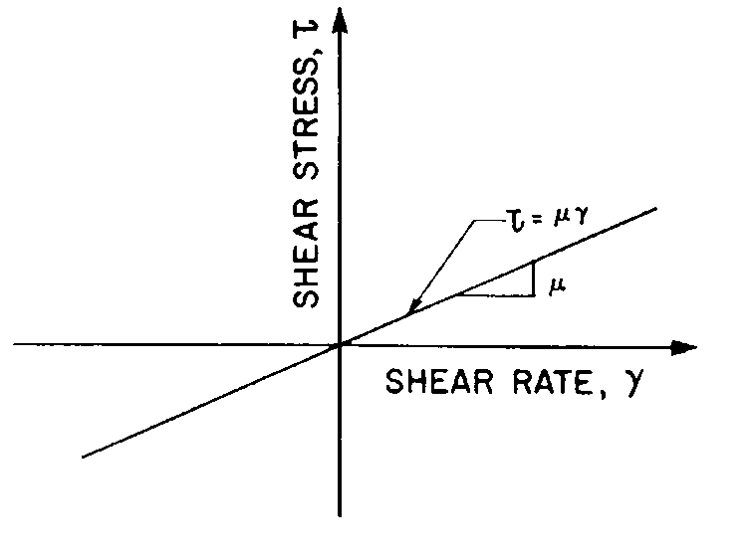

Newton’s Law of Viscous Flow
Consider a similar experiment (as described in the previous slide to establish Hooke’s Law) for a “rectangular prism” made of a simple liquid.
Shear rate = V/y
$$\dot{γ}=\frac{dγ}{dt}$$

Slide 10
Viscous Flow
The application of a particular shear stress will not result in a definite deformation (i.e. shear strain), but the liquid will deform and continue deforming as long as the shear stress is applied.
This continuous increase will occur no matter how small the applied shear stress, τ, but the rate at which this occurs will depend very much on τ.
In its simplest form (Newtonian liquid), the rate of deformation is directly proportional to the applied shear stress.

Slide 11
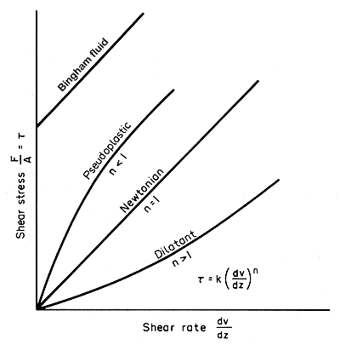
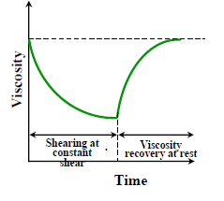
Types of Flow
Newtonian Fluid
Non-Newtonian Fluids
  Bingham Fluid
  Shear Thickening Fluid
  Shear Thinning Fluid
  Thixotropic Fluid
  (closest resemblance to cement paste)
Thixotropy

Slide 12
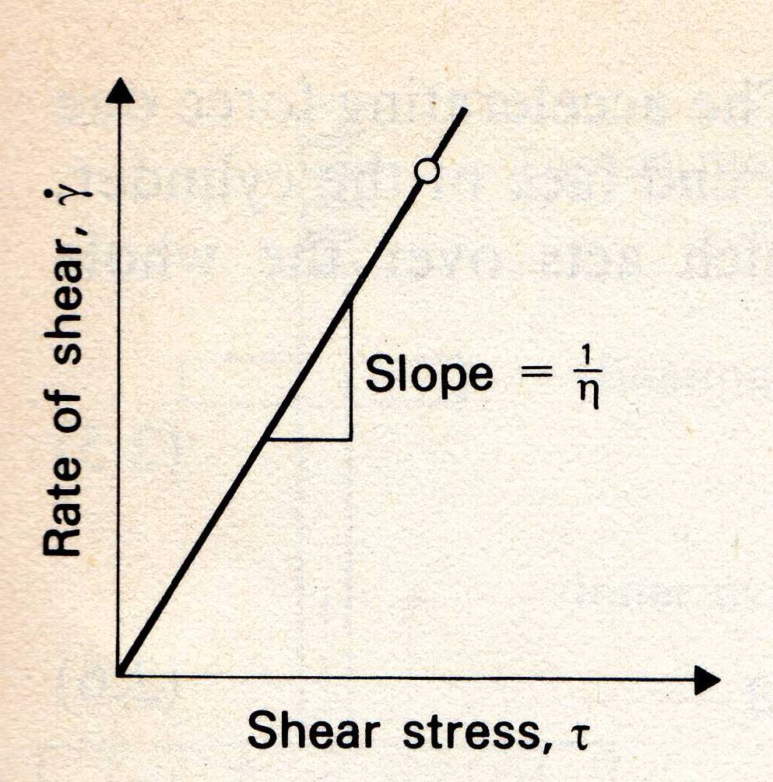


Newtonian Fluid
When the fluid flows regardless of how much it is being stressed, we have a Newtonian Fluid.
Shear stress, τ
Slope = η
Rate of shear, dγ/dt
$$\dot{γ}=\frac{dγ}{dt}$$

Slide 13


Bingham Fluid
Flow Curve
A Bingham fluid acts as a rigid body at low shear stress and flows like a viscous fluid at high shear.
Past the critical shear, it behaves as a Newtonian Fluid - there is a linear relationship between shear stress and shear rate.
The Bingham Model
Shear Stress, (Pa)
slope = plastic viscosity (μ)
intercept = yield stress (τ₀)
Shear Rate, (1/s)
$$\dot{γ}=\frac{dγ}{dt}$$

Slide 14
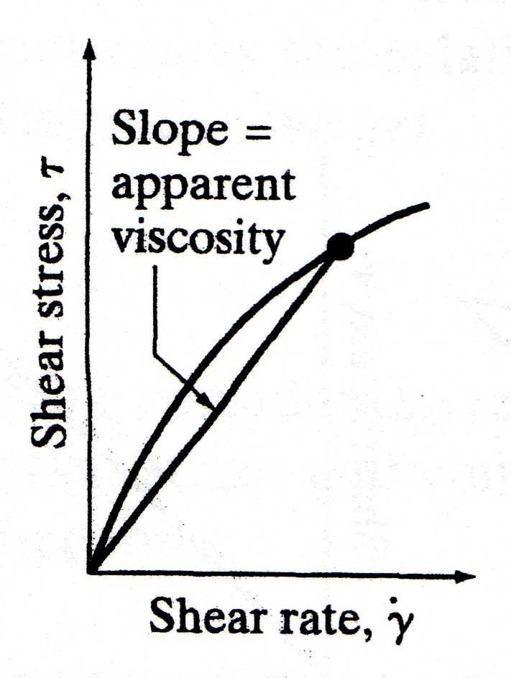


Shear Thinning
This type of liquid displays a decrease in the viscosity with an increase in the shear rate.
where, m < 1
$$\dot{γ}=\frac{dγ}{dt}$$

Slide 15
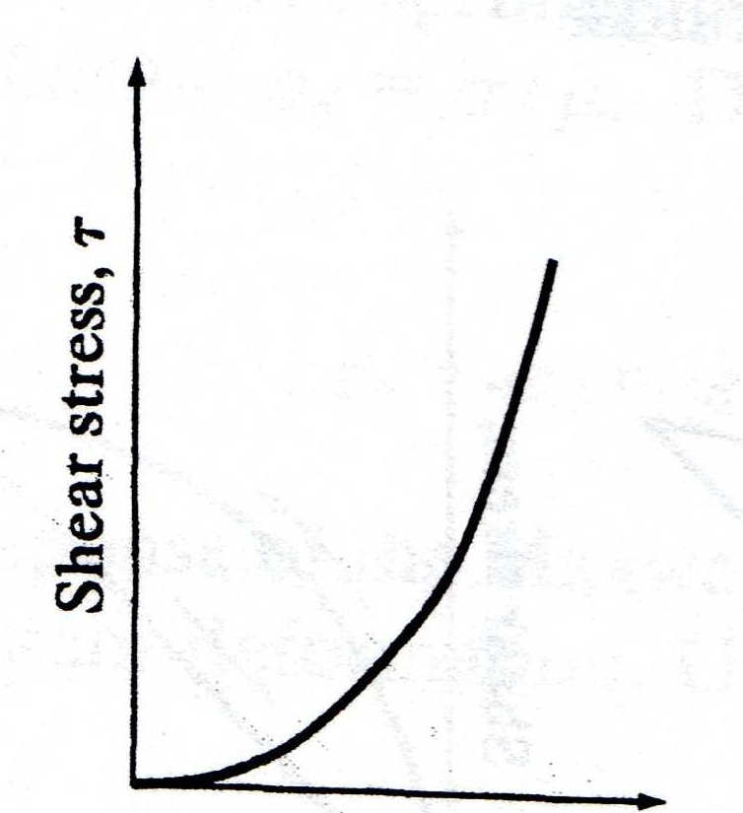

Shear Thickenning
Such fluids (also called dilatant fluids) exhibit an increase in viscosity with an increase in the shear strain rate.
where, m > 1
Shear rate, dγ/dt
$$\dot{γ}=\frac{dγ}{dt}$$

Slide 16
Thixotropic Fluid …(1)
A fluid which exhibits a drop in viscosity with time under a constant shear strain rate is said to be thixotropic.
The viscosity undergoes a gradual recovery when the shear stress is removed.
A truly thixotropic fluid will exhibit a completely reversible behaviour.
A pseudo thixotropic fluid does not completely return to its original state of yield stress.

Slide 17
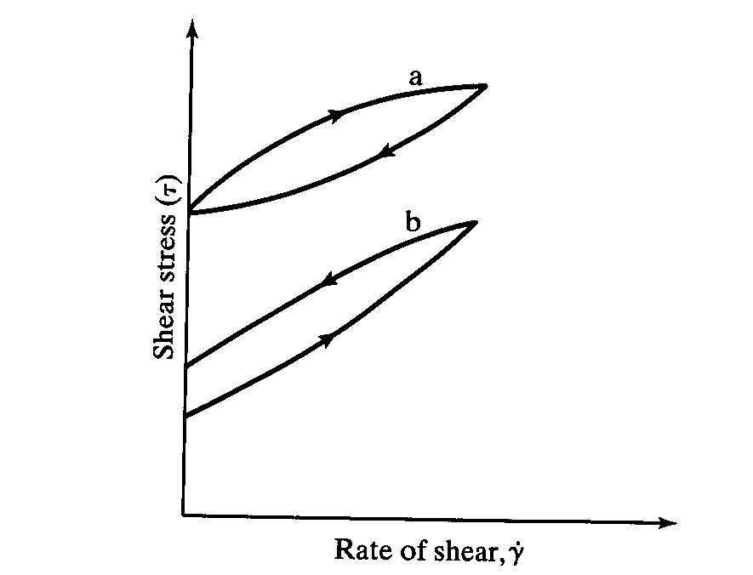
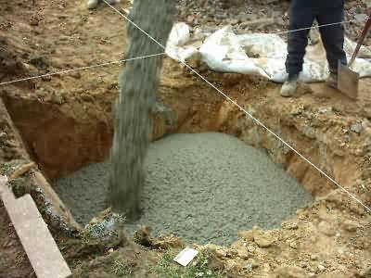

Thixotropic Fluid …(2)
Thixotropy
Truly thixotropic
Pseudo thixotropic
$$\dot{γ}=\frac{dγ}{dt}$$

Slide 18
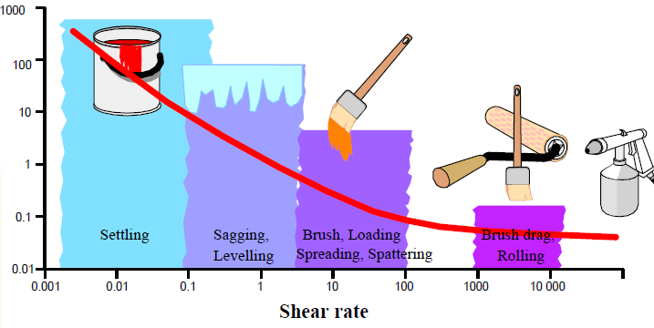
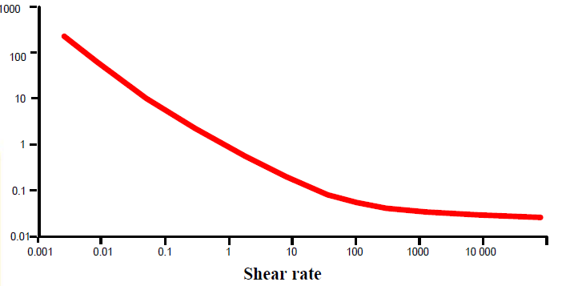
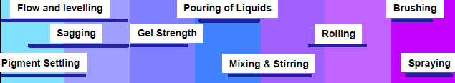
Rheology Profile and Applications
Viscosity

Slide 19
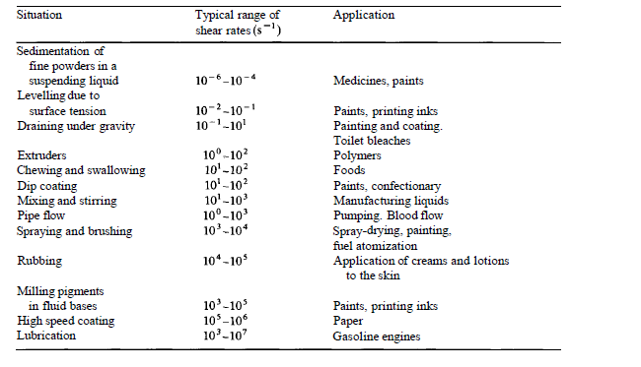

Shear rates of some familiar materials and processes

Slide 20
Common rotational viscometers (rheometers)
From Morrison Rheology Notes

Slide 21
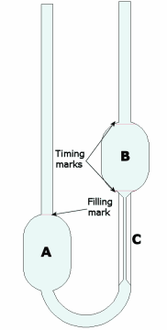
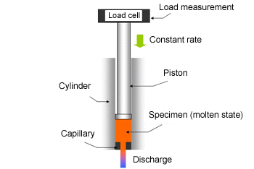
Capillary and piston viscometers
From Morrison Rheology Notes

Slide 22
Shear Oscillatory Measurements
Measured using rotational rheometers (strain or stress controlled), with cone-and-plate or parallel plate fixtures in the dynamic oscillatory mode.
  Stress sweeps: To identify linear viscoelasticity region. Very sensitive to branching and presence of fillers.
  Temperature sweeps: To identify temperature stability, degradation, crosslinking
  Frequency sweeps: Useful to detect structure of the material, viscous vs. elastic behaviour etc.
  Stress relaxation: To detect the relaxation modulus as a function of time.
Oscillatory measurements can also be performed on solid samples (i.e. rubber, polymers in the solid state) using DMA (Dynamic Mechanical Analyzer) instruments.
  Temperature sweeps are commonly used to identify glass transition temperatures, and damping properties (tanδ) of the solid samples.

Slide 23
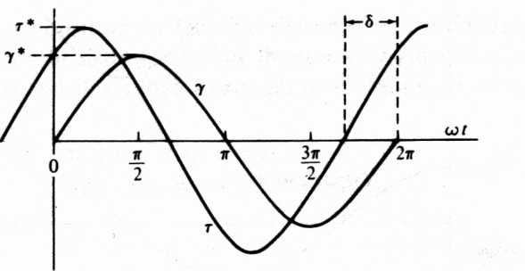
Dynamic (Oscillatory) Rheometry
In the general case when the sample is deformed sinusoidally, as a response the stress will also oscillate sinusoidally at the same frequency, but in general will be shifted by a phase angle δ with respect to the strain wave. The phase angle will depend on the nature of the material (viscous, elastic or viscoelastic)
Input
Response
where 0°<δ<90°

Slide 24
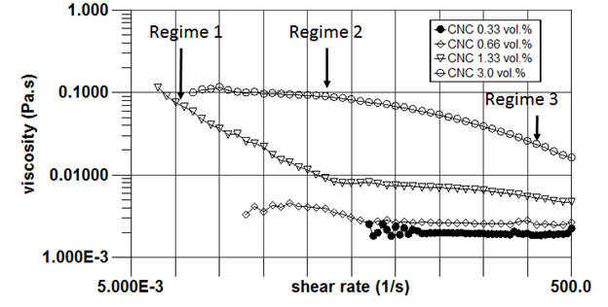
Steady state shear viscosities of CNC with L/D=12 at 0.33vol%

Slide 25
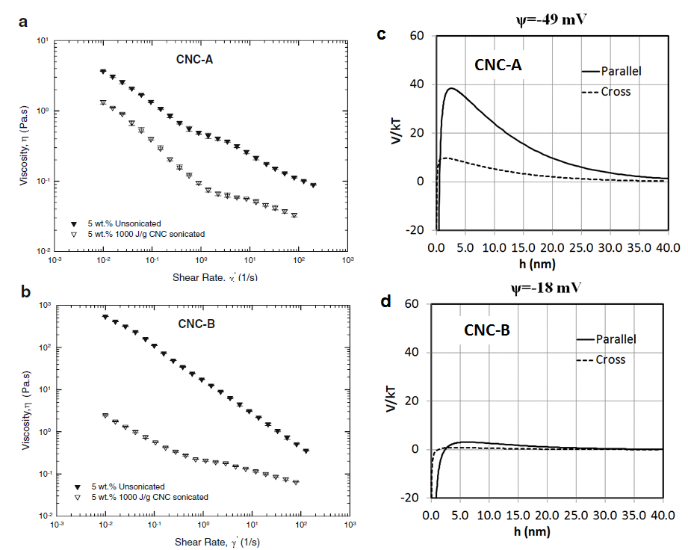
CNC surface charge effect on viscosity
. Viscosity vs. shear rate plots of: CNC-A (a); CNC-B (b) before and after sonication; Interaction energy (V/kt) between CNC rods in parallel and cross orientations vs particle-particle distance (h): CNC-A (a); CNC-b (b). V/kT calculations performed for particle diameter (d) = 7nm; length (L) =100 nm; Hamaker constant (A₁₂₃)=1.20x10-20 J.; Debye Length (κ⁻¹)=9.68 nm; Zeta potentials (ζ) are given on each plot. (a and b reprinted with permission from Ref. [15]. Copyright 2013 Springer).

Slide 26
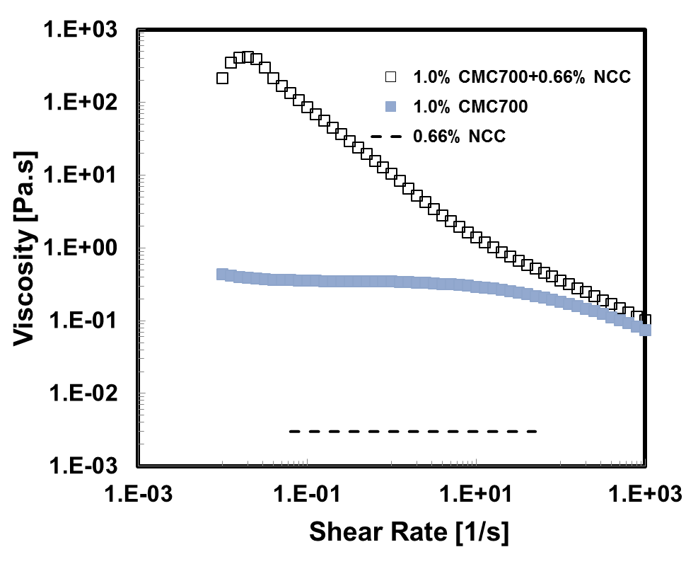
Rod Shaped Cellulose Nanocrystals
CNC is not a thickener in diluted and semi-diluted concentrations
However CNC (in semi dilute concentration range) at least 500 time enhances non-Newtonian characteristics of certain semi-dilute water soluble polymers.
Commercial potentials:
  Use of CNC at low concentrations
  Use as a rheology modifier in coatings, personal care, drilling fluids, and other functional fluids
Boluk and Zhao, US Patent 8,105,430 B2
Boluk et. al Langmuir, 28:6114-6123 (2012)

Slide 27
Shear viscosities of CNC in a) 0.5 % ; b) 1.0 % CMC solutions
T= 25⁰C
(a)
(b)
Oguzlu, Hale, Christophe Danumah, and Yaman Boluk. "The role of dilute and semi‐dilute cellulose nanocrystal (CNC) suspensions on the rheology of carboxymethyl cellulose (CMC) solutions." The Canadian Journal of Chemical Engineering 94.10 (2016): 1841-1847.

Slide 28
0.33 vol.% CNC suspension in CMC (700 kDa) solutions.
(a)
(b)

Slide 29
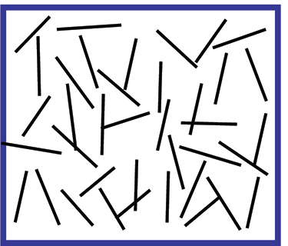

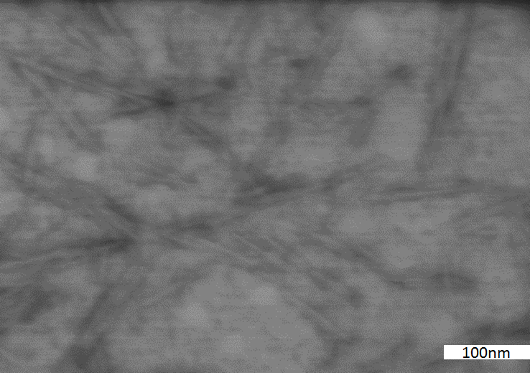
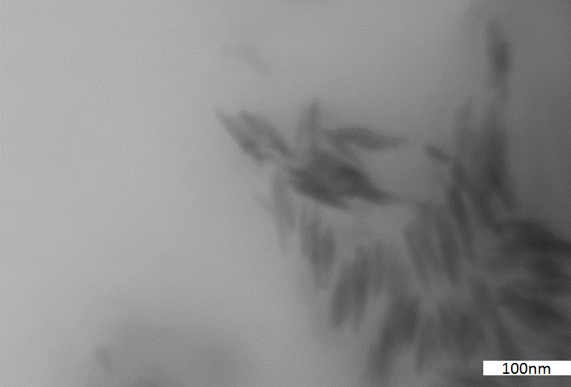
CNC Structure of Polymer Solutions
without the presence of non-adsorbing polymer
with the presence of depleted non-adsorbing polymer.
PEO-CNC
CMC-CNC
Boluk, Y.; Zhao, L. Y.; Incani, V. , Langmuir 24, 6114-6123 (2012)
29

Slide 30
Oscillation measurements of CNC in HEC solutions
G’(ω) and G”(ω) of CNC suspensions in 1.0% (wt) HEC solutions.

Slide 31
Flow behavior of CNF depends on the grade and concentration
From Webinar, May 27, 2015, Pia Qvintus& Heli Kangas, VTT Techncal Research Centre of Finland Ltd.

Slide 32
Oscillation measurements of CNF suspensions
Lasseuguette, Elsa, Denis Roux, and Yoshiharu Nishiyama. "Rheological properties of microfibrillar suspension of TEMPO-oxidized pulp." Cellulose 15.3 (2008): 425-433.

Slide 33
CNC in PLA melt
Kamal, Musa R., and Vahid Khoshkava. "Effect of cellulose nanocrystals (CNC) on rheological and mechanical properties and crystallization behavior of PLA/CNC nanocomposites." Carbohydrate polymers 123 (2015): 105-114.

Slide 34
CNC in PP melt
Khoshkava, Vahid, and Musa R. Kamal. "Effect of cellulose nanocrystals (CNC) particle morphology on dispersion and rheological and mechanical properties of polypropylene/CNC nanocomposites." ACS applied materials & interfaces 6.11 (2014): 8146-8157.

Slide 35
CNC in PP melt (Oscillation test)
Khoshkava, Vahid, and Musa R. Kamal. "Effect of cellulose nanocrystals (CNC) particle morphology on dispersion and rheological and mechanical properties of polypropylene/CNC nanocomposites." ACS applied materials & interfaces 6.11 (2014): 8146-8157.

Slide 36
Concluding remarks
Steady state shear viscosity measurements
Dynamic measurements (Oscillation)
Further things to learn
  Elongational viscosity
  Creep test
  Stress relaxation
  And more

